Slide 1
Skillpilot – ai based personalized course advisor
CAPSTONE PROJECT
Presented By:
1. Siddhartha Gummadi - AVN Institute of Engineering and Technology - CSE(AI&ML)

Slide 2
OUTLINE
Problem Statement
Proposed System/Solution
System Development Approach
Algorithm & Deployment
Result
Conclusion
Future Scope
References

Slide 3
Problem Statement
Example: Students often struggle to identify the right learning path that aligns with their interests and long-term goals due to the overwhelming number of online courses and a lack of personalized guidance.

Slide 4
Proposed Solution
The proposed system, SkillPilot , aims to address the challenge of helping students identify the right learning path based on their interest, current skill level and long term career goals. It leverages agentic ai and generative language models to deliver adaptive, personalized course recommendations. The solution consists of the following components:
User Input Understanding :
Engage users in natural conversation to gather input about their interests (e.g., Frontend Development, Cyber Security), existing knowledge and career goals.
Use Contextual questioning to guide uncertain users toward clarity in their learning direction.
Dynamic course recommendation Engine :
Use IBM’s Granite LLM (via watsonx.ai) to analyse user responses and generate a personalized course roadmap.
Recommend foundational to advanced courses progressively, ensuring logical learning flow.
Integrate Google Search to fetch real-time course options from platforms like Coursera, edX, IBM SkillsBuild etc..
Adaptive Roadmap Construction :
The agent suggests learning paths that adapt over time based on the user’s progress and follow up queries.
Introduce checkpoints and stage wise guidance (Beginner → Intermediate → Advanced).
Deployment :
Developed using IBM watsonx Agent Builder on IBM Cloud Lite.
Deployed within a secure, testable deployment space.
Offers preview functionality through watsonx’s built-in chat interface.
Evaluation :
Responses Evaluated based on accuracy , relevance and clarity of learning paths suggested.
Iteratively improved through prompt refinement and test user feedback.

Slide 5
System Approach
The "System Approach" section outlines the overall strategy and methodology for developing and implementing the SkillPilot AI Based Personalized Course Advisor.
System requirements
IBM Cloud ( Lite Tier Account )
Access to watsonx.ai and Watson Assistant ( Agent Builder )
Internet connectivity for enabling tool based we search
Deployment space for permissions to preview and interaction
Library required to build the model
Watson Assistant ( Agent Builder ) – For no code conversational logic
Granite-3-3-8b-instruct (IBM LLM) – for intelligent, instruction-following dialog
Google Search Tool – for real – time course suggestions

Slide 6
Algorithm & Deployment
Algorithm Selection
SkillPilot uses the Granite-3-3-8b-instruct model, a large language model (LLM) developed by IBM. It is designed for following instructions and understanding natural language. This makes it perfect for engaging user interactions and creating personalized learning paths. The model was chosen because it meets the needs for adaptive, contextual, and multi-turn dialogue in an agentic AI system.
Data Input
Instead of numerical data, SkillPilot processes natural language inputs from users. This includes:
- Area of interest (for example, “Frontend Development” or “Data Science”)
- Current skill level (beginner, intermediate, or advanced)
- Career goals (this is optional)
- Real-time course suggestions fetched using the Google Search Tool
Training Process
Granite models are pre-trained by IBM on large datasets and adjusted for business use. No extra training was done by hand. Instead, prompt engineering and system instructions were refined to direct responses. The prompts mimic expert guidance by organizing learning suggestions in a clear, easy-to-use format.
Prediction Process
When a user inputs a query, the agent:
Parses the natural language input.
Uses prompt templates to frame a contextual response.
Queries the Google Search Tool if needed to fetch live course options.
Returns a step-by-step roadmap that includes skills, tools, and certification paths.
The model adjusts the response based on user history within the session, context, and question type. This makes each roadmap uniquely tailored to the learner.

Slide 7
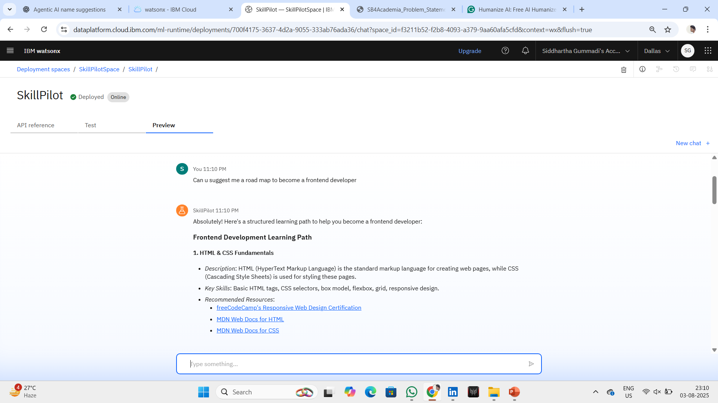
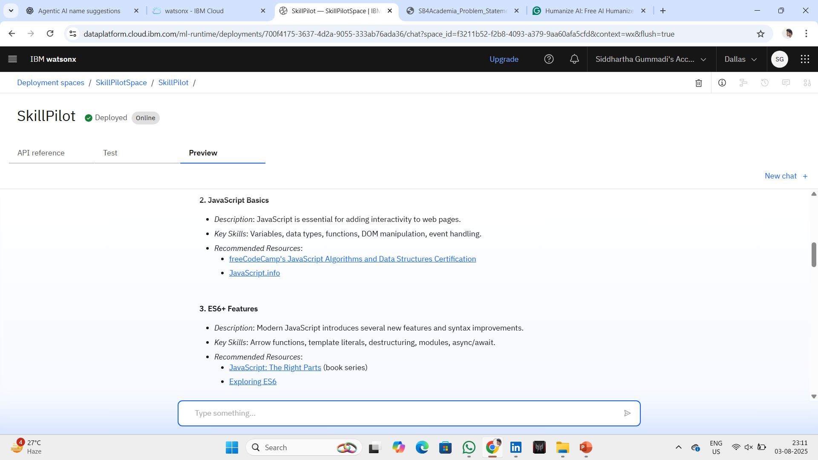
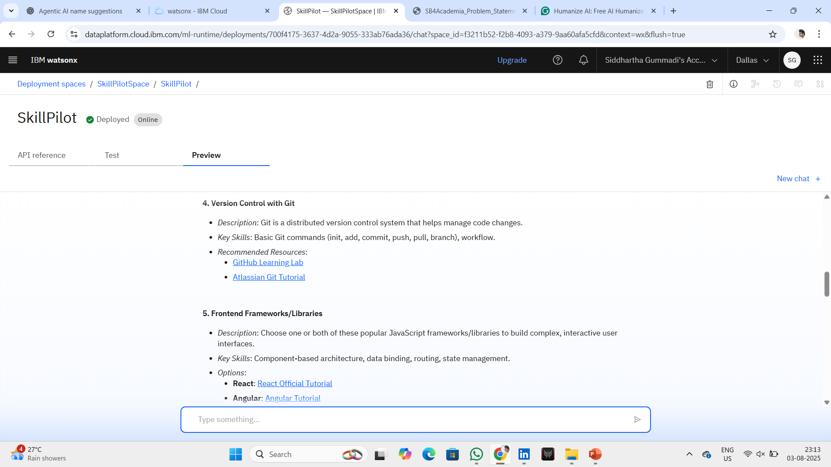
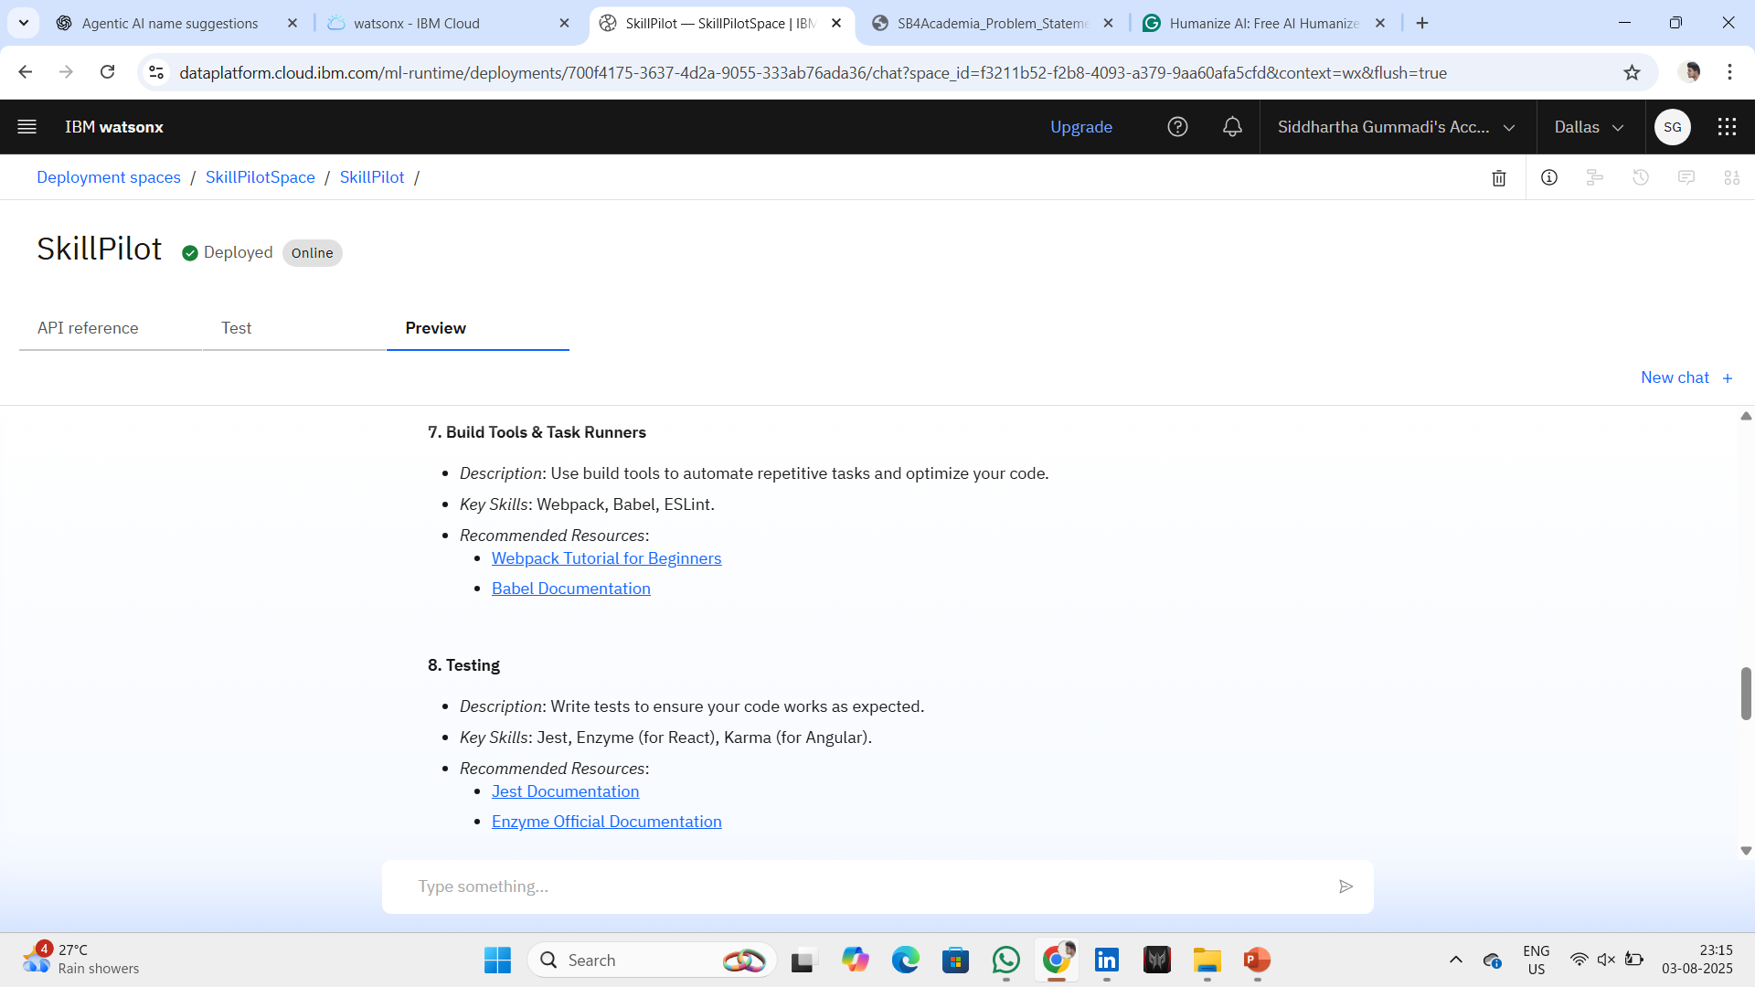
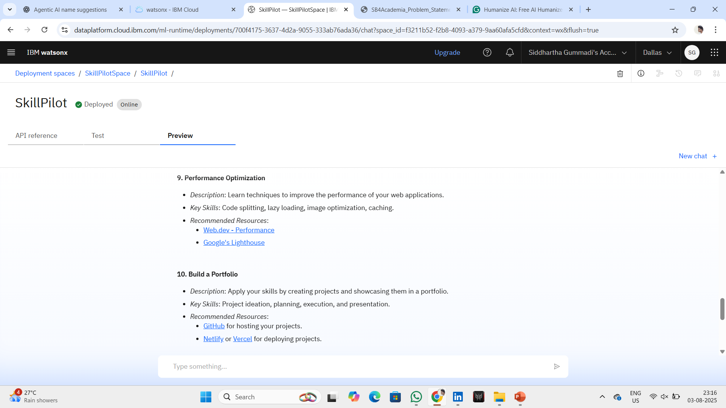
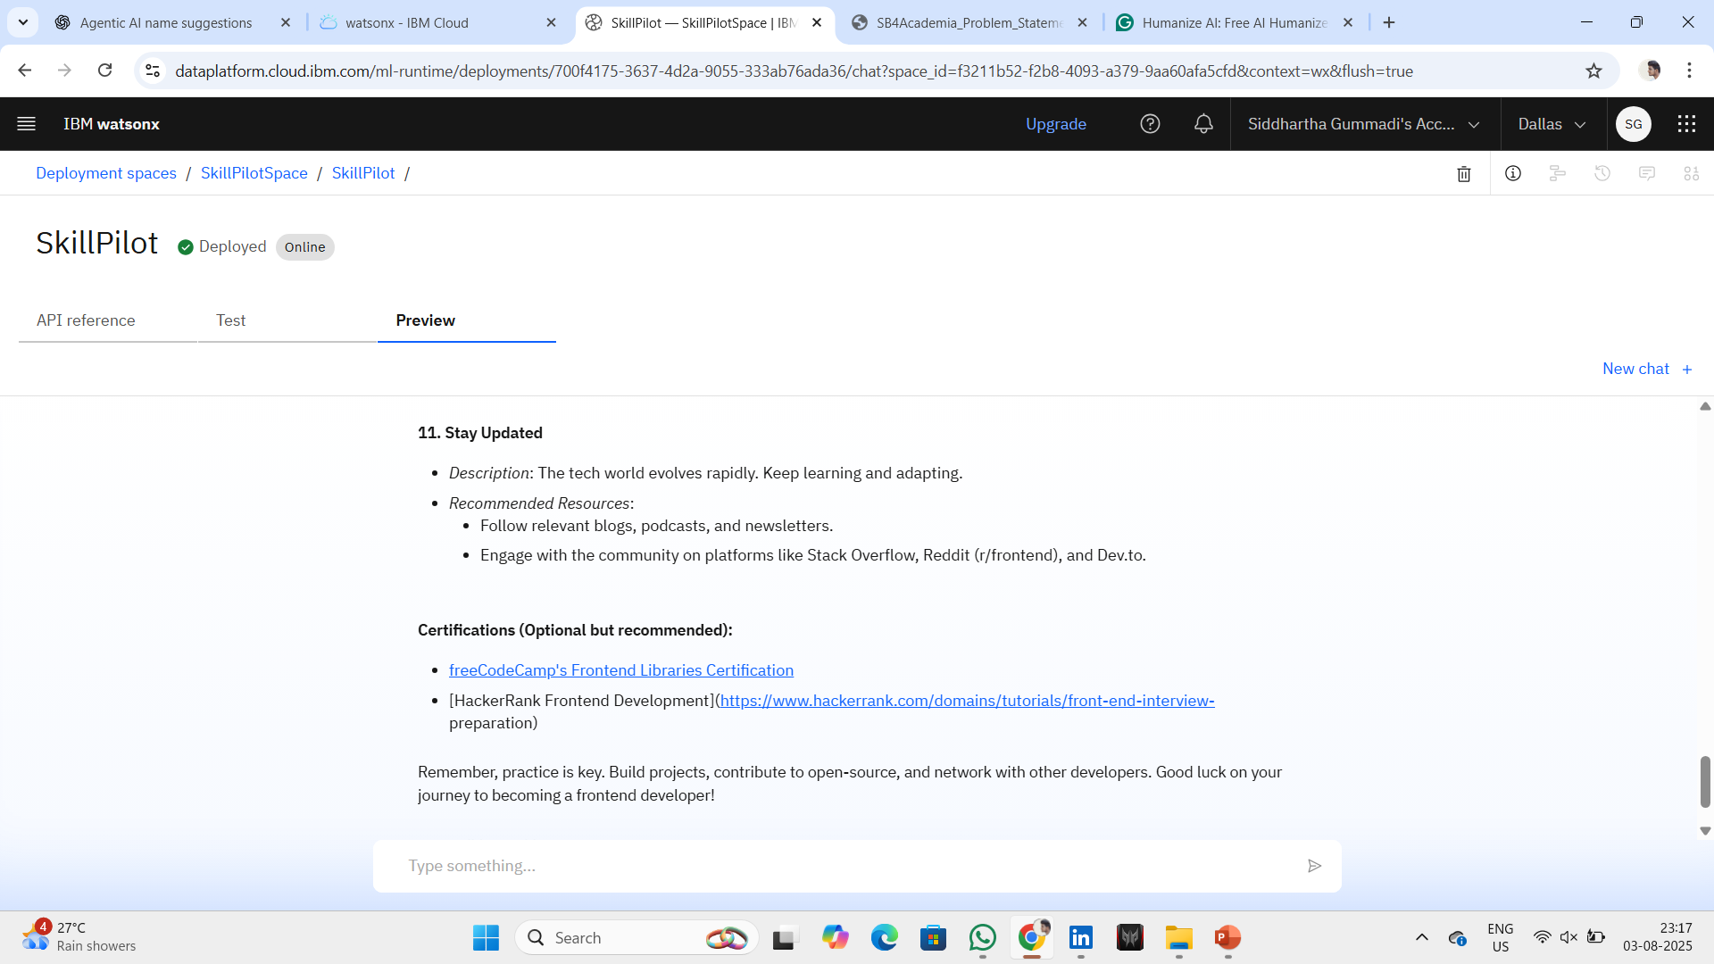
Result

Slide 8
Conclusion
The SkillPilot rollout demonstrated how effective agentic AI can be at providing personalized learning path recommendations. By using IBM watsonx services and the Granite foundation model, the system engaged users in meaningful conversations. It created dynamic and structured roadmaps based on their interests and goals.
During development, a major challenge was creating effective prompts. This was necessary to ensure the agent could respond to different types of user input. Limitations in memory persistence and tool availability also required flexibility with prompts instead of depending on complex logic.
Despite these challenges, the system performed well by generating relevant suggestions. It showed promise as a helpful learning companion. This solution illustrates how AI can help reduce decision fatigue for learners and improve access to targeted upskilling in digital education.
GitHub Repository Link : https://github.com/siddharthagummadi/SkillPilot-IBM-Cloud-Project

Slide 9
Future scope
Add memory to keep user history and learning progress across sessions.
Integrate real-time course APIs, such as Coursera, edX, and IBM SkillsBuild, for better recommendations.
Introduce multilingual support to help learners from different backgrounds.
Incorporate voice-based interaction to enhance accessibility.
Use analytics to adjust prompts and boost agent performance.
Expand deployment to schools and learning platforms for broader adoption.

Slide 10
References
IBM watsonx Documentation, https://www.ibm.com/products/watsonx
IBM Granite Foundation Models, https://www.ibm.com/blog/announcements/granite-models
IBM watsonx Assistant Agent Lab, https://dataplatform.cloud.ibm.com
Prompt Engineering Guide, https://github.com/dair-ai/Prompt-Engineering-Guide
Google Search Tool Integration, IBM watsonx Agent Tooling
Coursera and edX APIs for course discovery concepts
Research on AI in Education:
Holmes, W., Bialik, M., and Fadel, C. (2019). Artificial Intelligence in Education: Promises and Implications for Teaching and Learning.

Slide 11
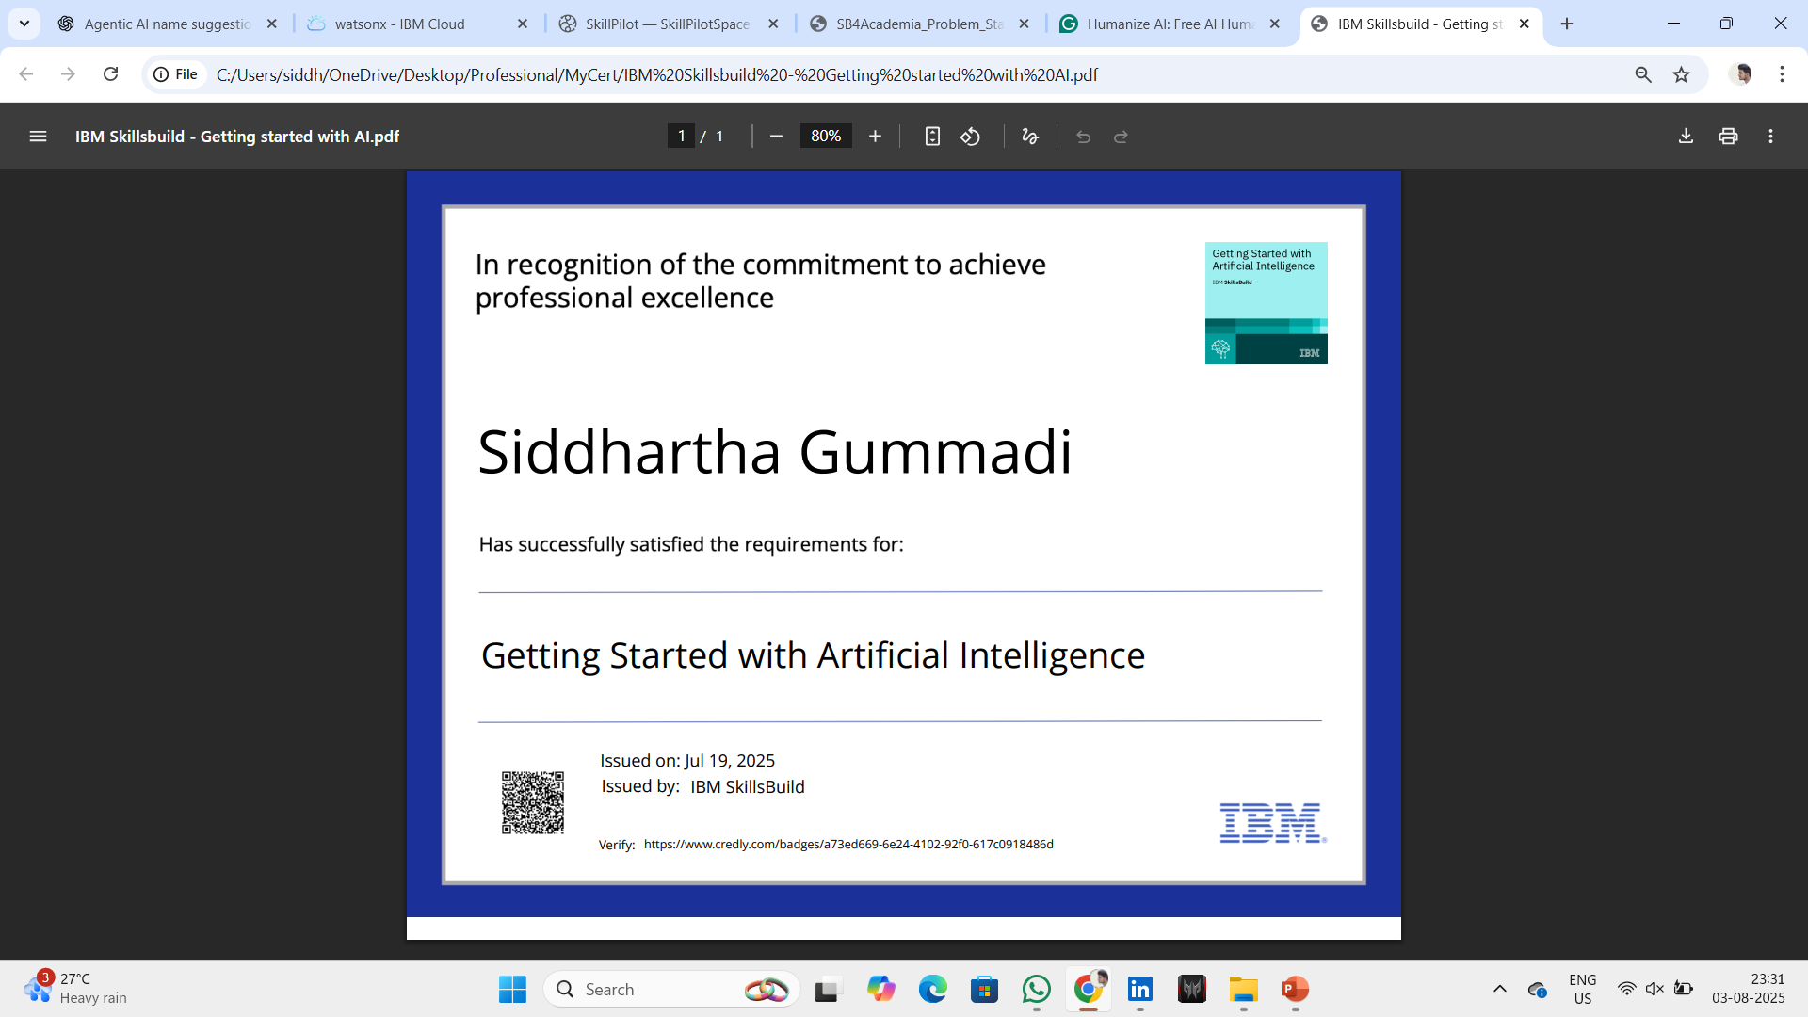
IBM Certifications

Slide 12
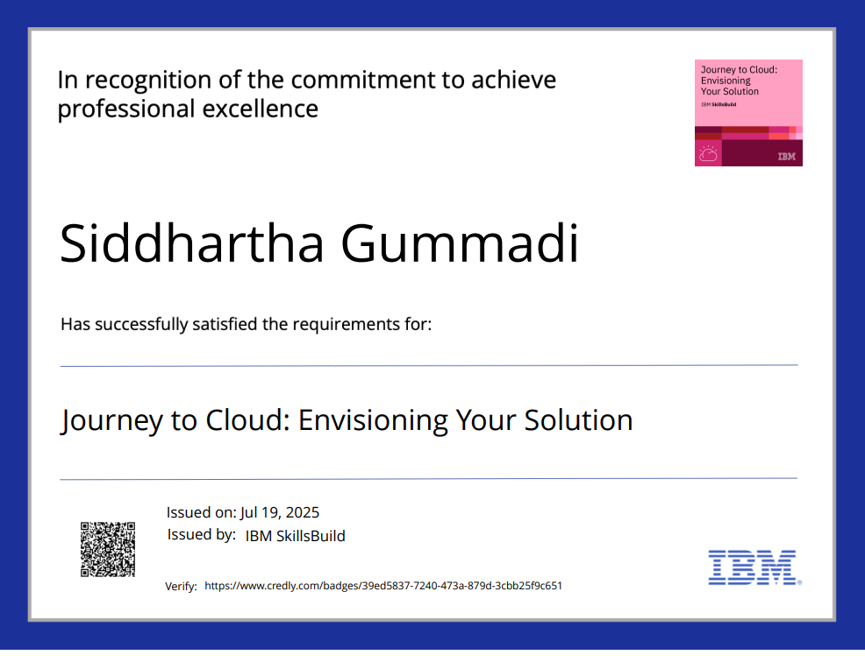
IBM Certifications

Slide 13
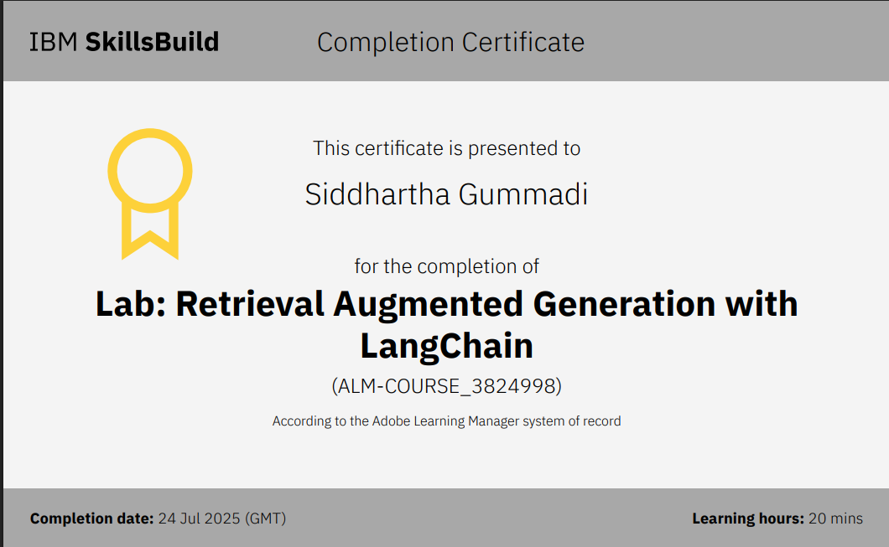
IBM Certifications

Slide 14
THANK YOU

